Slide 1
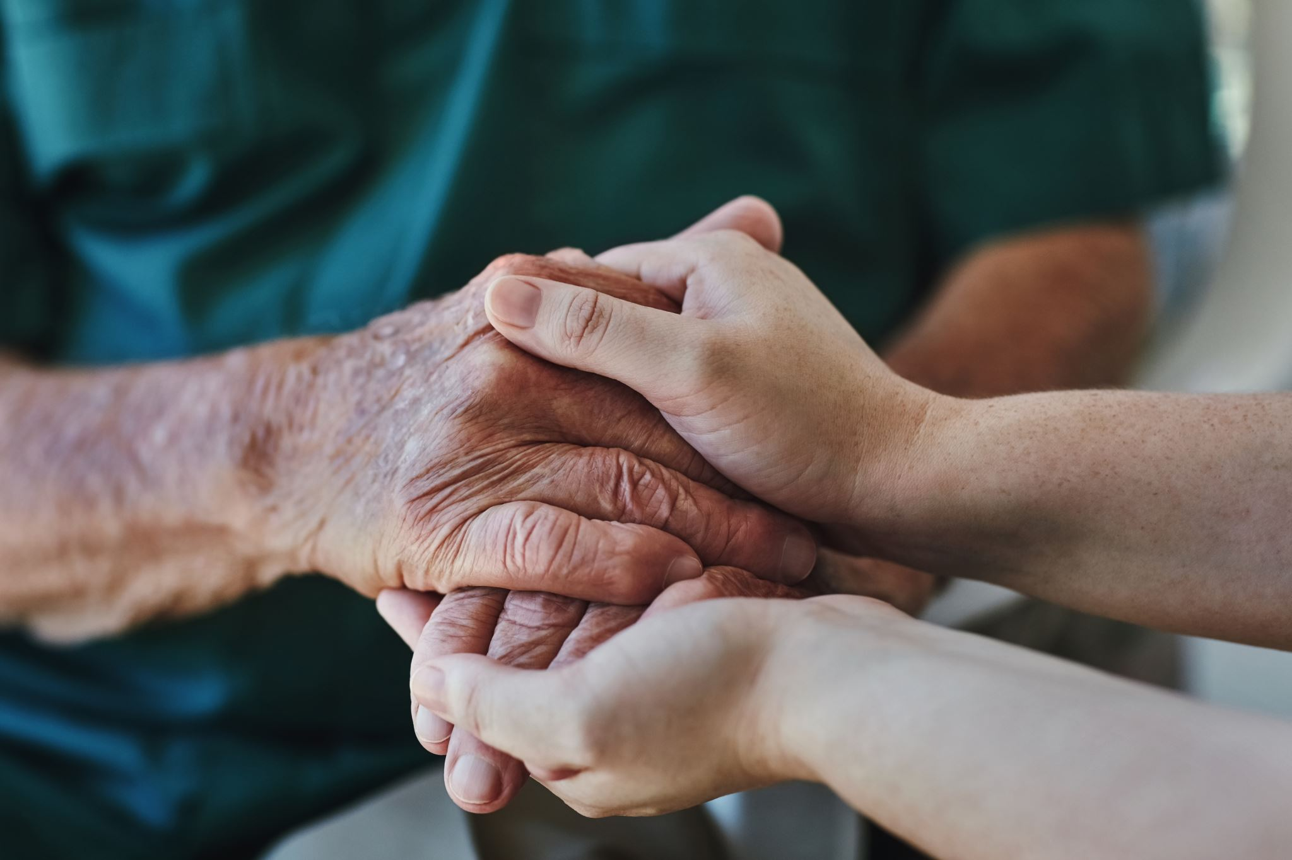
Rights of Older Women in Pakistan
Dr. Aneela Sultana
“A society that respects its elderly women secures its future.”

Slide 2
Introduction
15+ million people aged 60+ in Pakistan (7% of population).
Older women face triple disadvantage: age, gender, poverty.
Rights guaranteed by law but often ignored in practice.

Slide 3
Rights matter ……
Human Value: Every woman, regardless of age, deserves respect, security, and a life free from neglect or discrimination
Social Contribution: Older women continue to enrich families and communities, often serving as the backbone of intergenerational support.
Future Protection: The rights we guarantee for today’s older women are the same rights that will safeguard today’s younger women in the future

Slide 4
Ageing a Social Issue
Ageing cannot be experienced in isolation. Gender, class, caste, ethnicity and other social categories mediate how ageing unfolds. Older women in patriarchal societies may experience marginalization not only because of their age but also due to lifelong economic dependency or limited access to education and healthcare. An intersectional approach to the anthropology of ageing calls for attention to the ways in which structural inequalities lead to divergent ageing experiences.

Slide 5
Rights of Older Women
Right to social protection (pensions, assistance).
Right to healthcare (geriatric & reproductive).
Right to family support & dignity.
Right to participation & decision-making.
Right to safety, inheritance, and property.

Slide 6
Objectives of the study
To assess how older adults perceive their changing socio-economic conditions, including health decline, dependency, and family support, and explore their response to the physiological, emotional, financial and social pressure to perform old age according to the cultural expectation.
To explore the gendered experience of ageing, particularly how patriarchal norms in South Asian societies affect older men and women differently in terms of care, social status, and emotional support.
These objectives are aimed to understand how older adults experience marginalization not merely due to age-related decline but also through societal devaluation, reduced access to resources and shifting intergenerational dynamics. This research has also focused how social capital, social inclusion, isolation, and intergenerational support differ significantly for men and women as they age.

Slide 7
Key Challenges
Economic insecurity: only 2.3% women get pensions.
Healthcare neglect: lack of specialized services.
Social isolation: weakened family support.
Abuse & discrimination: neglect, inheritance denial.
Institutional gaps: few effective old-age homes.

Slide 8
Reflections from Fieldwork
Bodily decline and the reconfiguration of physical autonomy
Non-communicable diseases (NCDs) (hypertension, diabetes, cardiovascular disease) and geriatric impairments are common among older adults in Pakistan; age is a major risk factor.
Health care in old age and family structures

Slide 9
Physical vulnerability and loss of agency
Structural erosion of financial power in old age
Own home and property as sources of control
Shared financial management in joint families
Cultural conditioning and learning to behave old
Reflections from Fieldwork

Slide 10
Policy Recommendations
Dignity does not expire with age, and justice belongs to every stage of life
Senior Citizens Act Implementation
Inheritance Rights
Economic Empowerment and Social Security
Healthcare and Well-being
Social Inclusion and Protection

Slide 11
Conclusion
Supporting older people and particularly older women to have a secure income through universal social pensions should be a priority in Pakistan. Ensuring that health services are aligned to the health needs of the older population especially at the primary health care level is essential to assist older people to remain active in their communities. Finally, eliminating all forms of age discrimination and providing an environment in which older people are protected from violence and abuse will help them exercise their choices and contribute to society.

