Slide 1
Climate Change and Ageing in Pakistan: Impacts and Policy Pathways for Protecting Older People
Muhammad Mumtaz, PhD
Fatima Jinnah Women University, Rawalpindi, Pakistan

Slide 2
Scheme of Presentation
Introduction
Global Context
Pakistan’s Context
Policy Measures
Policy Gap
Policy Recommendations
Conclusion and way forward

Slide 3
Introduction
Climate change is recognized as “greatest health threat of the 21st century” (WHO)
Older adults (60+) disproportionately exposed to risks
Multiple dimensions: health, mobility, social security, displacement
Often overlooked in climate adaptation and disaster response

Slide 4
Why Older People are at higher risk?
Climate change
Reduced physiological resilience (weakened immunity, chronic diseases)
Limited mobility, harder evacuation during disasters & dependency on medications
Economic vulnerability: fixed/low incomes limit adaptation options
Ageism in policy frameworks leads to exclusion

Slide 5
Global Context
01
02
03
World’s population aged 65+ will reach 1.6 billion by 2050 (UN DESA, 2022)
80% will live in low- and middle-income countries
Extreme weather events increasing in intensity and frequency (IPCC, 2022)
04
05
Older people more likely to live in poor housing and hazard-prone areas
Social systems under strain to support aging and climate crises simultaneously

Slide 6
Heatwaves
WHO: 166,000 global deaths due to heat waves (1998–2020), mostly 60+
Older adults less able to regulate body temperature
High prevalence of cardiovascular & respiratory diseases
Urban “heat islands” make cities deadly for elderly
Lack of cooling access worsens mortality risk

Slide 7
Air Pollution & Respiratory Issues
Older adults more prone to chronic pulmonary diseases, asthma, heart disease
South Asia = home to 5 most polluted cities globally
Indoor air pollution (biomass fuels) affects rural elderly

Slide 8
Mental Health Impacts
Trauma from displacement & disasters
Loss of homes, livelihoods, social networks
Increased depression, anxiety, PTSD in elderly
Loneliness amplifies distress; weak psychosocial support
Few age-sensitive mental health programs
Climate disasters worsen “silent suffering” of elderly

Slide 9
Extreme Weather Events
Disasters = injury, loss of medicines, disrupted healthcare
Elderly often excluded from relief distribution
Post-disaster recovery slower due to health decline

Slide 10
Pakistan’s Context
01
02
03
Population aged 60+: 16.5 million (6.9% of population) (2023)
By 2050 → ~36.5 million elderly (≈10% of population)
NCDs = 85% of disease burden among elderly (cardio & respiratory leading)
04
05
06
2022 floods: 71.4% of elderly reported illness/disability post-flood
87% of elderly in flood areas had a chronic condition, but only 51% accessed healthcare
2024 heat wave: 568 deaths reported in Karachi morgue, many elderly

Slide 11
Pakistan’s Context
07
08
09
~69% of elderly lacked proper shelter, 63% lacked toilets, 62% lacked bathing facilities in flood zones
78% of elderly in Sindh reported insufficient food; 59% lacked clean drinking water post-floods
post-floods, only 24% of elderly reported any income; majority dependent on family or aid
10
11
12
only ~2.3% of elderly outside public sector receive pensions → high vulnerability
reduces average life expectancy by 3.9 years nationally; in Lahore, up to 7 years lost if trends persist; causes ~128,000 deaths annually (many elderly)
2022 floods: 33 million affected, thousands of elderly displaced
Notes:
The <World Health Organization (WHO)’s University of Chicago’s Energy Policy Institute (EPIC) in its latest Air Quality Life Index (AQLI)

Slide 12
Pakistan’s Policy Response to Climate Change
National Climate Change Policy of Pakistan (NCCP)
Ensure that the elderly, children, disabled and women get particular priority in evacuation strategies
Framework for Implementation of NCCP
Set-up system where old, children and disabled get particular focus during evacuation.
Establishment of Climate Change Council and Climate Change Authority
18th Constitutional Amendment

Slide 13
Pakistan’s Policy Response to Climate Change
Emergence of Provincial Climate Change Policies:
Punjab Climate Change Policy: Nothing
Punjab Climate Change Policy and Action Plan: Safe, affordable, accessible and sustainable transport systems women, children, persons with disabilities and older persons
KPK-Climate Change Policy: Create evacuation plans with consideration for women, children, disabled and elder people.
KPK-Climate Change Action Plan: Nothing

Slide 14
Pakistan’s Policy Response to Climate Change
Sindh: Climate Change Policy – 2022-Nothing
Balochistan Climate Change Policy-2024….increasing the vulnerability of the most marginalised segments of society, particularly women, children, persons with disabilities and the elderly as well as a major segment of the poor population.

Slide 15
Policy Gaps in Pakistan
No clear age-inclusive climate policy framework
Gaps between ministries (Climate Change, Health, Social Welfare) hinder integrated responses.
Absence of systematic research on how climate hazards (heatwaves, floods, GLOFs) specifically affect the elderly.
Lacks elderly-focused evacuation plans
Weak health infrastructure: ~2,000 facilities destroyed in floods

Slide 16
Policy Gaps in Pakistan
Low healthcare investment
Poor data collection: age-disaggregated mortality largely missing
Resource Constraints
Social and Cultural Factors-neglect, social isolation, and dependency, reducing their visibility in policymaking.
Limited Political Voice of Older People-underrepresentation in advocacy networks and climate governance forums.

Slide 17
Recommendations for Pakistan
Integration of policy actions towards the elder population in national and provincial climate policies
Ensure representation of elderly groups in policymaking
Make ageing central to climate adaptation policies
Strengthen collaboration: Govt + NGOs + UN agencies + academia
Invest in research & age-disaggregated data systems
Introduce climate-health insurance for older adults
Expand community-based support networks for the elderly

Slide 18
Conclusion
Climate change is a risk multiplier for older adults
Elderly face disproportionate health & livelihood threats
Pakistan needs urgent age-inclusive policies
Protecting older people = protecting community resilience
“No one left behind” must include the elderly.
Ensure climate justice

Slide 19
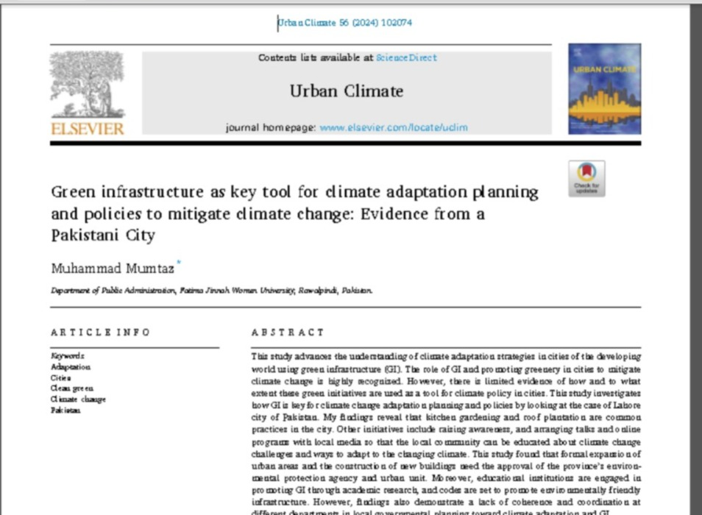
RELATED WORK

Slide 20
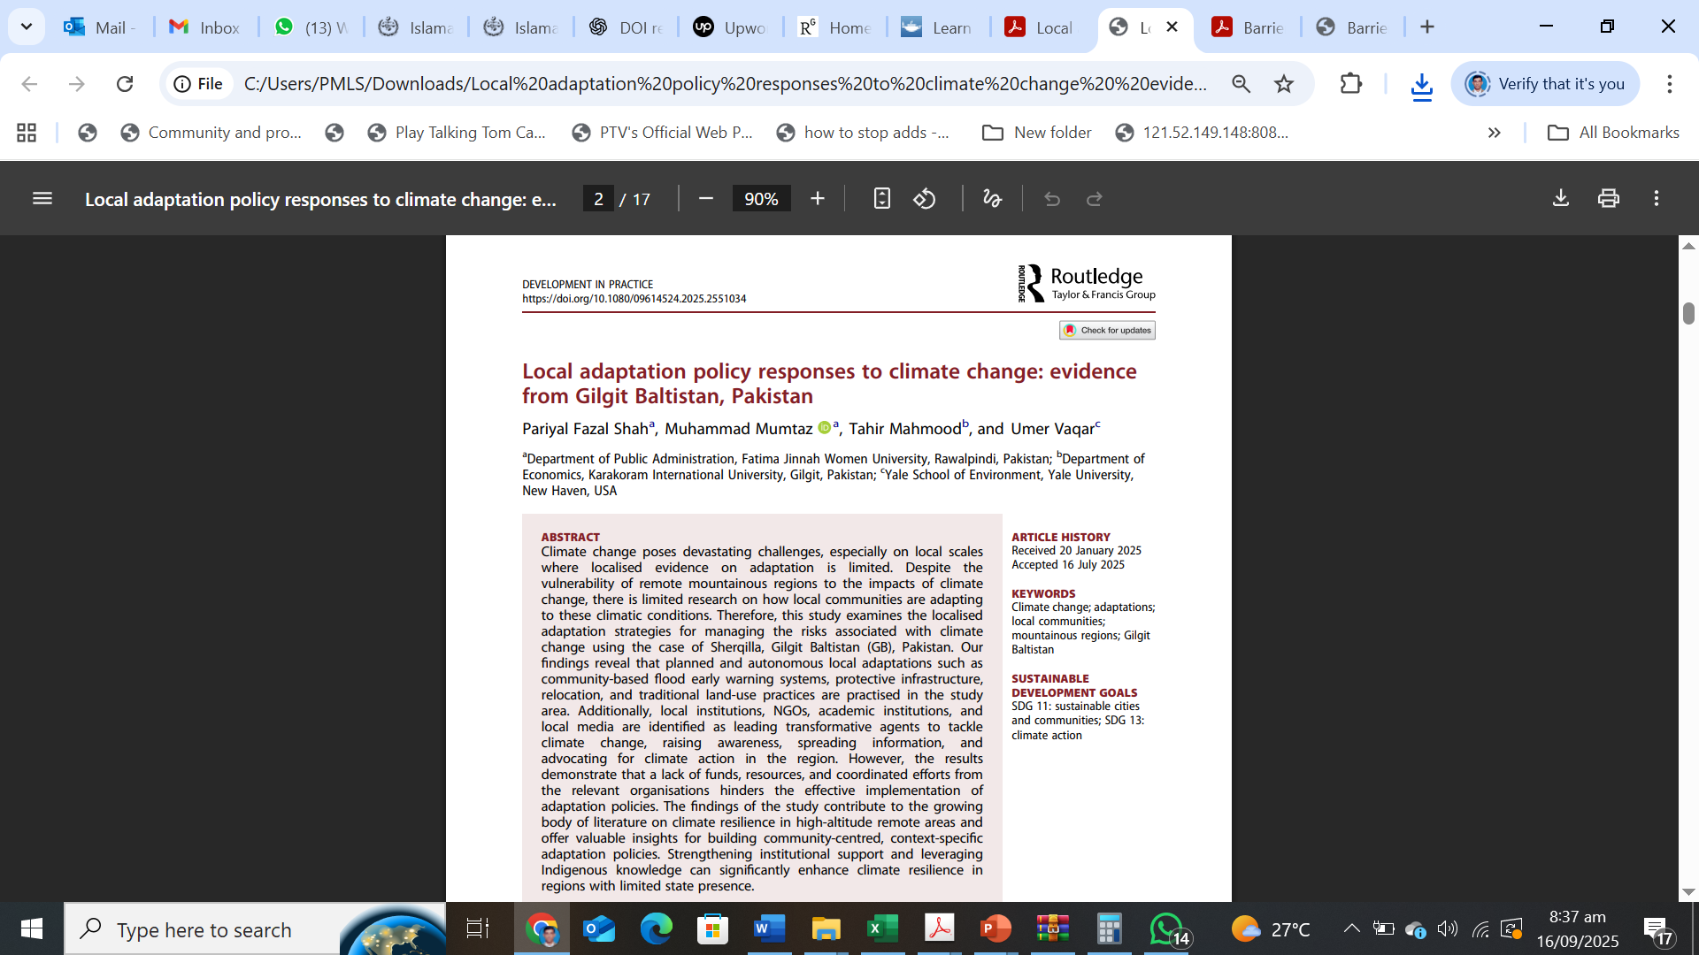
RELATED WORK

Slide 21
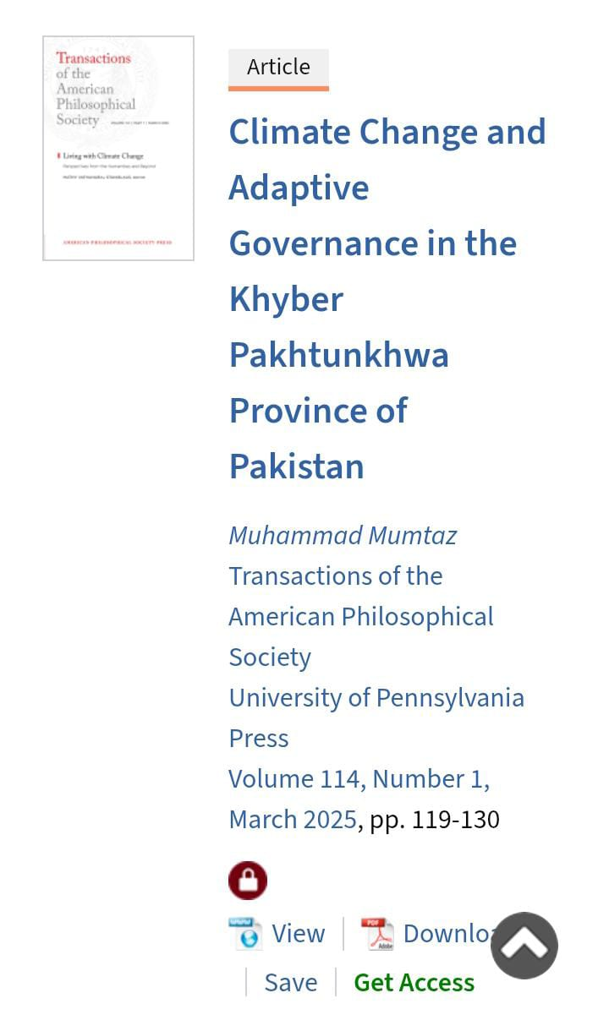
RELATED WORK

Slide 22
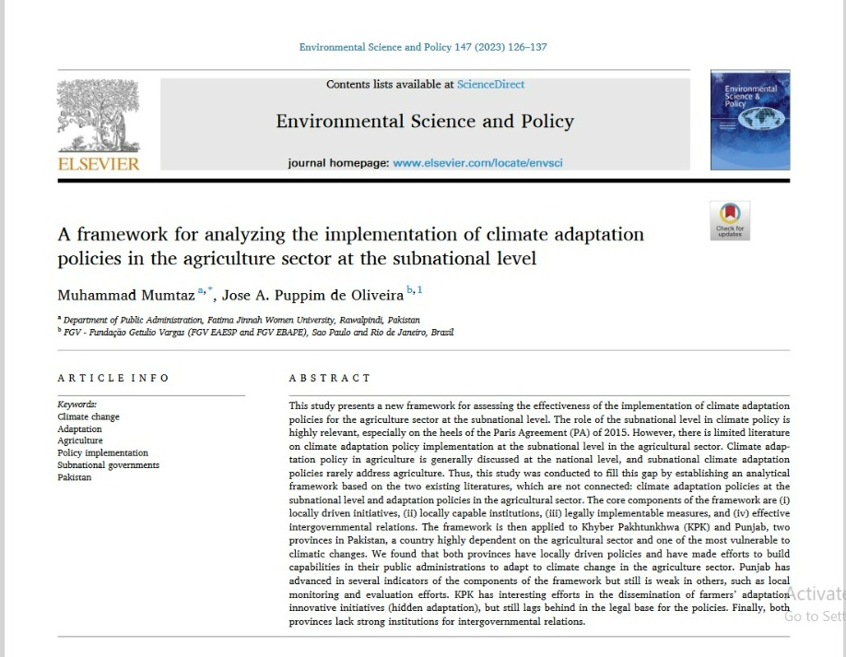
RELATED WORK

Slide 23
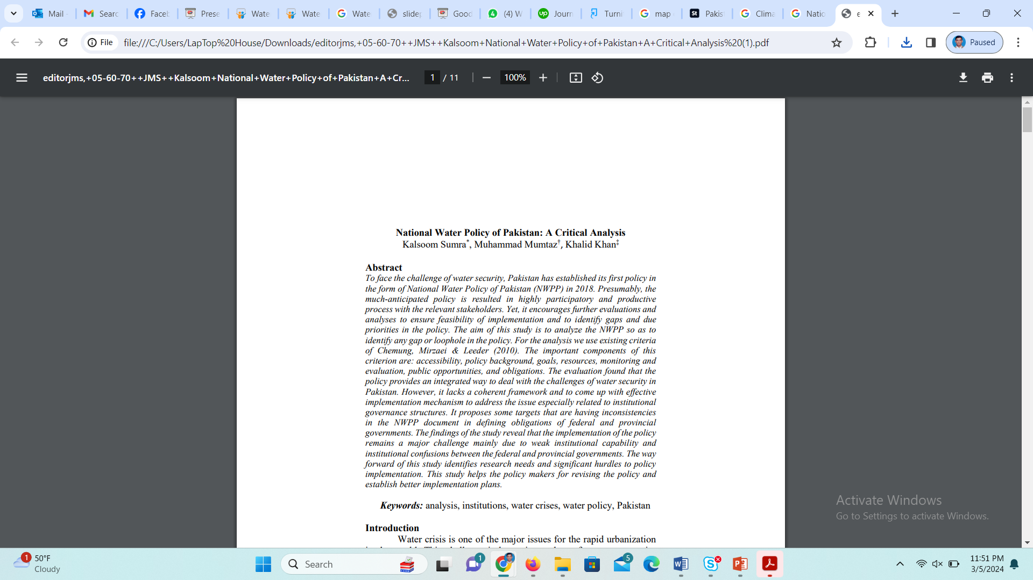
RELATED WORK

Slide 24
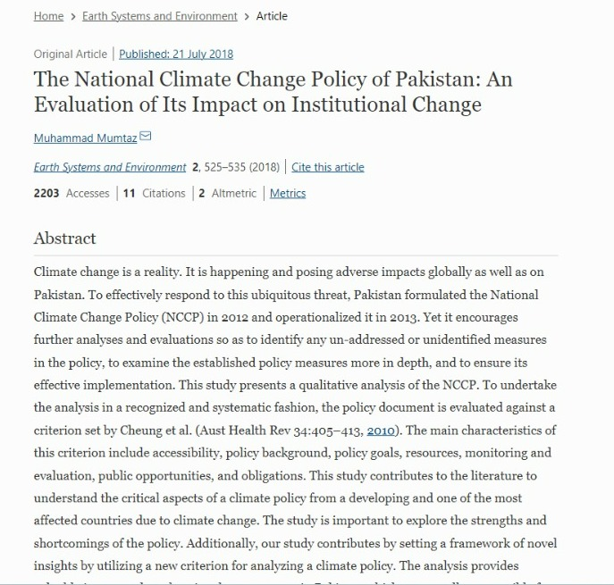
RELATED WORK

Slide 25
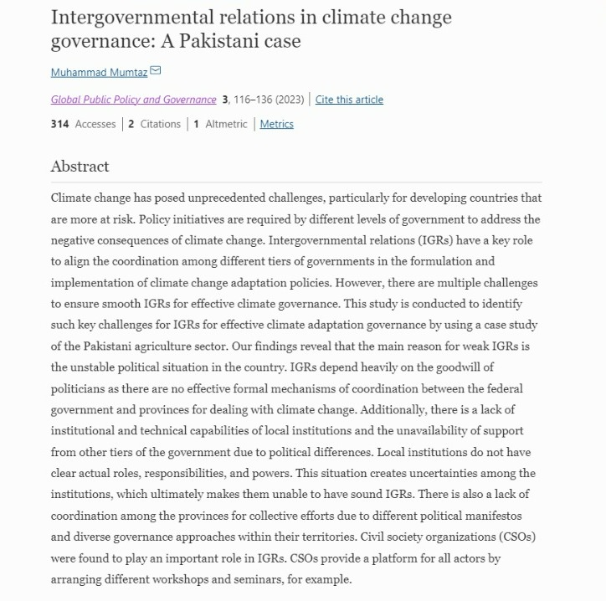
RELATED WORK

Slide 26
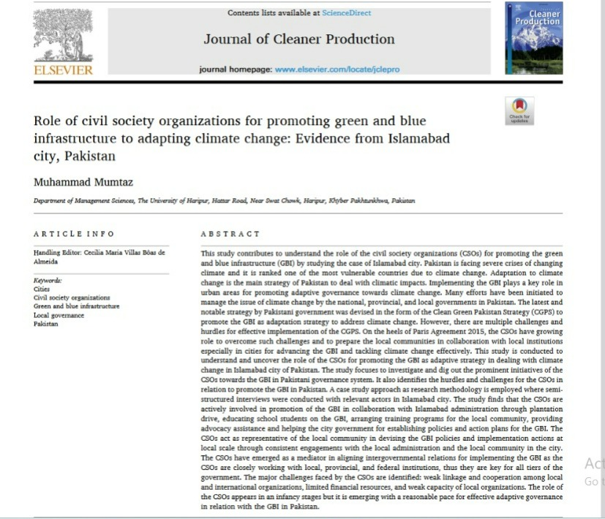
RELATED WORK

Slide 27
References
WHO (2021). Climate Change and Health
UN DESA (2022). World Population Prospects
IPCC (2022). Impacts, Adaptation & Vulnerability
German watch (2021). Global Climate Risk Index
UN OCHA (2022). Pakistan Floods Revised Response Plan
Amnesty International (2025). Uncounted: Invisible deaths of older people…
WHO Country Health Profile – Pakistan (2021/22)
Dawn, Arab News, The News International (2022–23 reporting)
Human Rights Watch (2023). Air Pollution Shortens Lives in Pakistan

Slide 28
THANK YOU!

